Slide 1
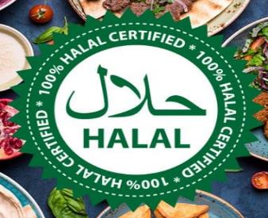

Find Halal Food at different location

Slide 2
Introduction where you discuss the business problem and who would be interested in this project.
If someone will immigrate to USA and he need to be near from restaurant provide Halal food since he is Muslim , so the problem how to choose location have a lot of Halal restaurant

Slide 3

Data where you describe the data that will be used to solve the problem and the source of the data.
I will use the FourSquare API to collect data about locations of Halal Restaurant in 5 major US cities which are: New York,NY, San Francisco, CA, Jersey City, NJ, Boston, MA and Chicago,IL. These are one of the most populated US.

Slide 4

Methodology
My main target here is to asses which city would have the highest Halal Restaurant density. I used the Four Square API through the venues channel. I used the near query to get venues in the cities. Also, I use the CategoryID to set it to show only Halal Restaurant Places.
That 52e81612bcbc57f1066b79ff is the Id of the Halal Restaurant Place Category. Also, Foursquare limits us to maximum of 100 venues per query.

Slide 5
Methodology
I repeated this request for the 5 studied cities and got their top 100 venues. I saved the name and coordinate data only from the result and plotted them on the map for visual inspection.
Next, to get an indicator of the density of Halal Restaurant Places, I calculated a center coordinate of the venues to get the mean longitude and latitude values. Then I calculated the mean of the Euclidean distance from each venue to the mean coordinates. That was my indicator; mean distance to the mean coordinate.

Slide 6
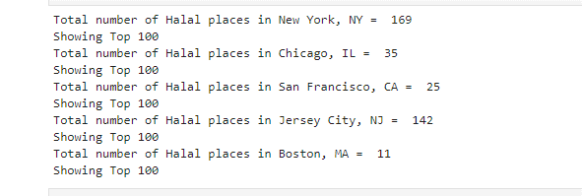
Results
For our initial visual inspection we see that they all have multiple Halal Restaurant places and often more than Foursquare would like to supply us. The following here are the pictures of the geoplot generated with folium:

Slide 7
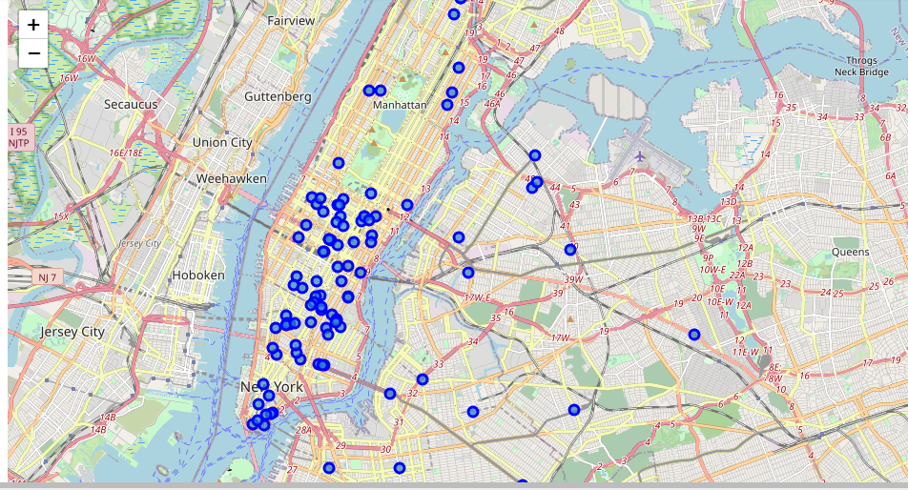
Results
New York

Slide 8
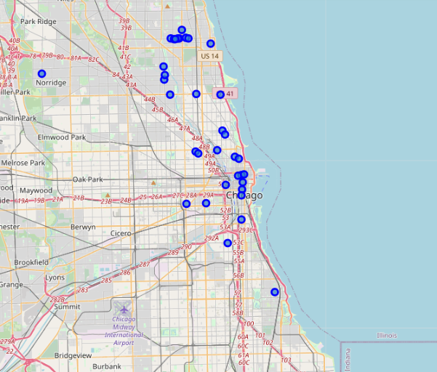
Results
Chicago

Slide 9
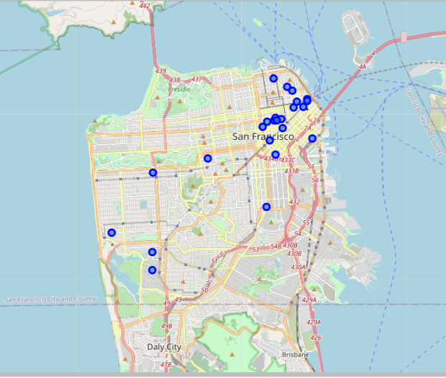
Results
San Francisco

Slide 10
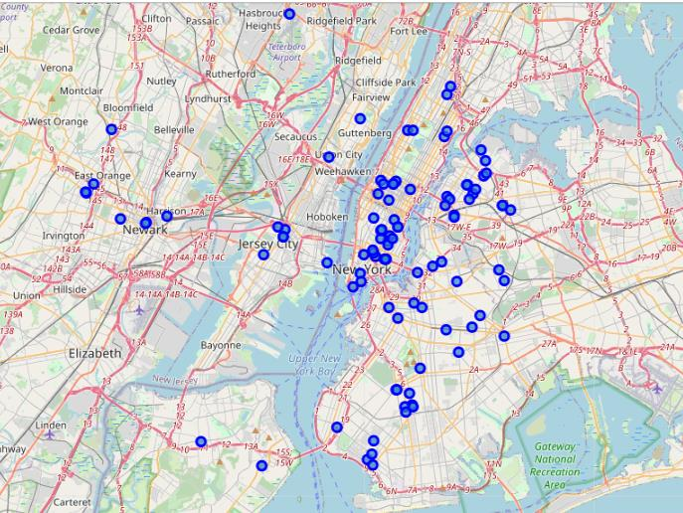
Results
Jersey City

Slide 11
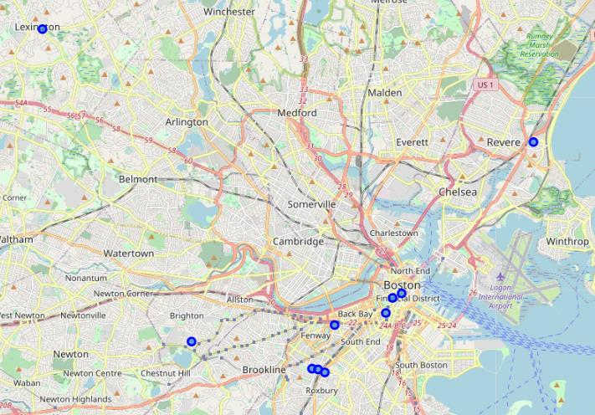
Results
Boston

Slide 12
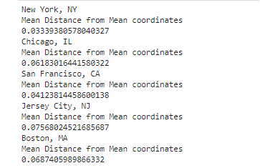
Results
Based on First inspection we see that New York and Jersey City are the most densely cities. In the next phase we Calculate the Mean coordinate and the mean distance to mean coordinate(MDMC). We represent the mean coordinate with a big green circle and distances with green lines

Slide 13
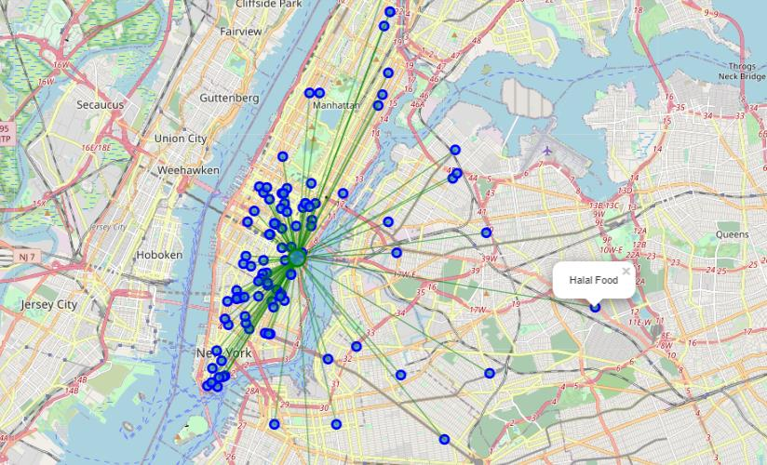
Results
New York

Slide 14
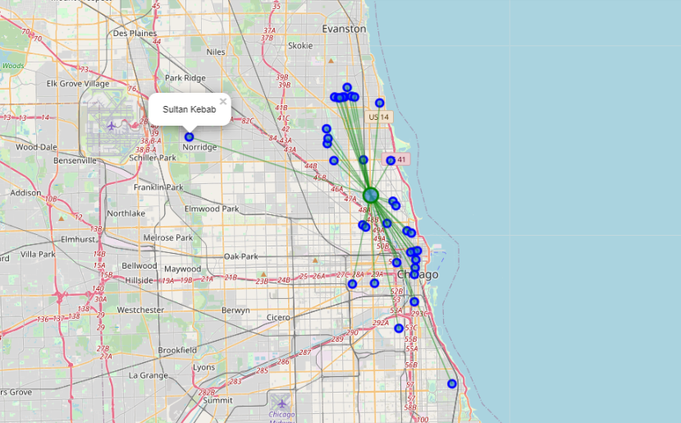
Results
Chicago

Slide 15
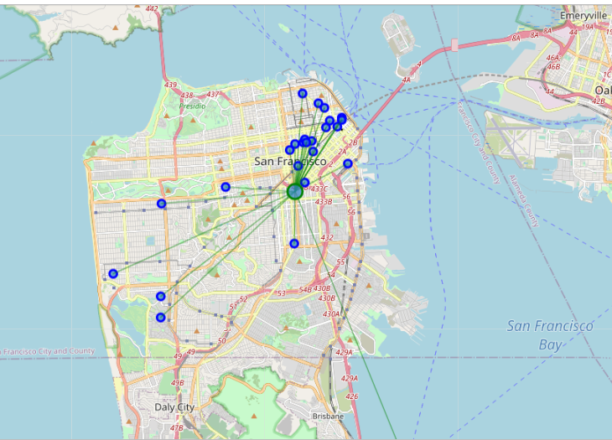
Results
San Francisco

Slide 16
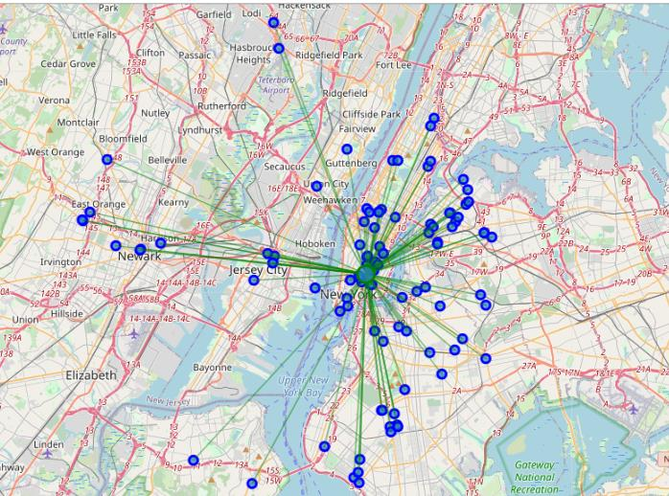
Results
Jersey City

Slide 17
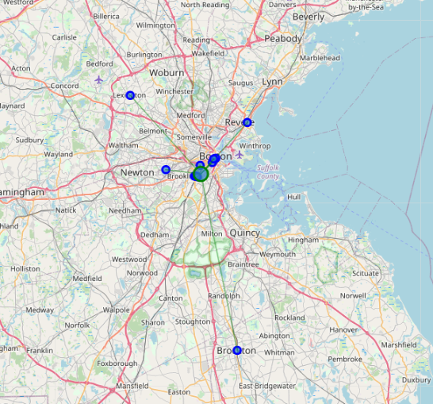
Results
Boston

Slide 18
Discussion
I Notice that based on the number of Hala Restaurant at the five cities that the competition will be between New York City and Jercy city and as per what we see New York will be better
Since MDMC is the best value

Slide 19
Conclusion
It is clear as crystal now that NEW YORK is the best location for Muslim people how try t travel to USA

